Slide 1

The role of climate legacies in shaping extinction risk throughout Earth's history
University of Bayreuth
Gregor Mathes
PhD Defense
02.02.2023

Slide 2

One of the defining features of the Anthropocene is that the world is changing in ways that compel species to move
Elizabeth Kolbert, The Sixth Extinction: An Unnatural History

Slide 3
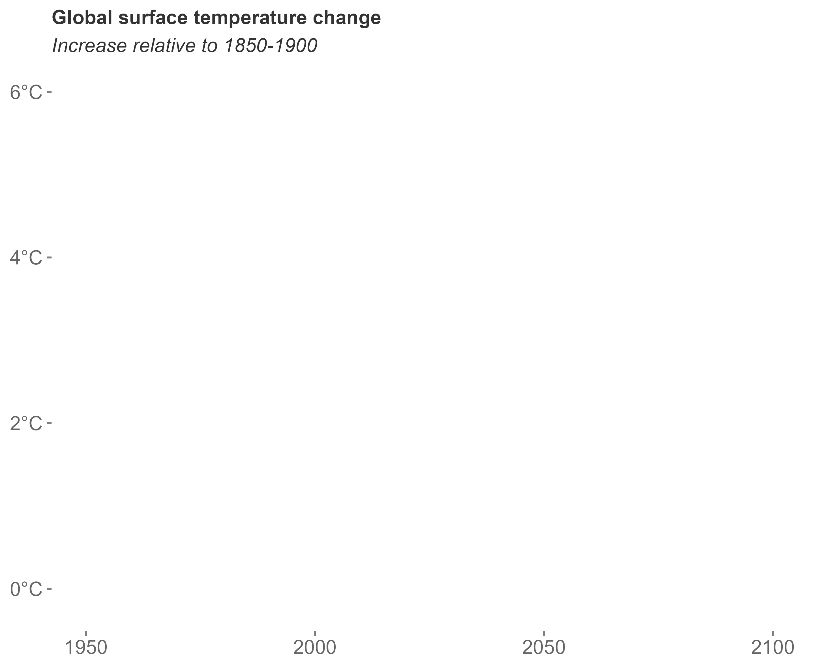
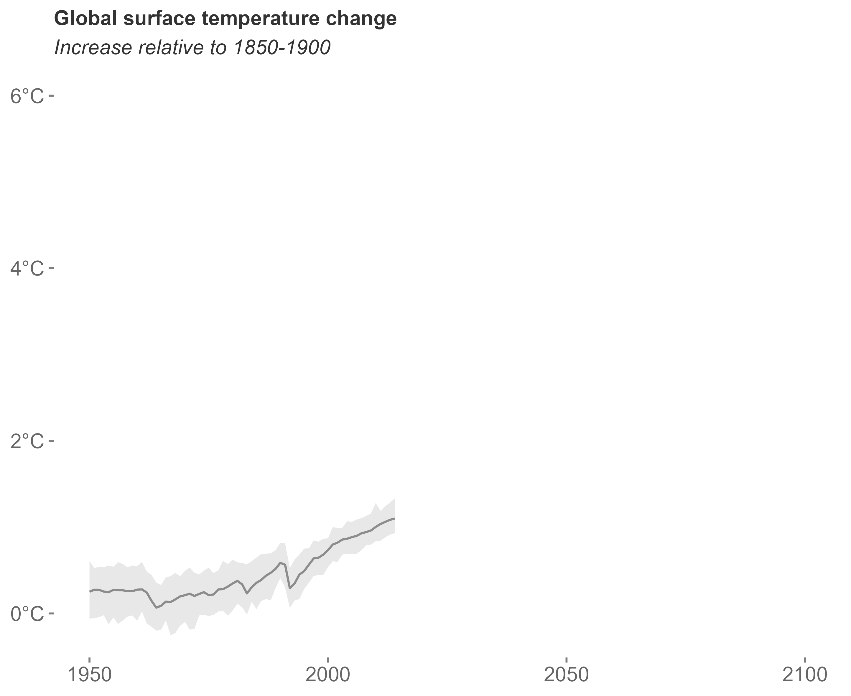
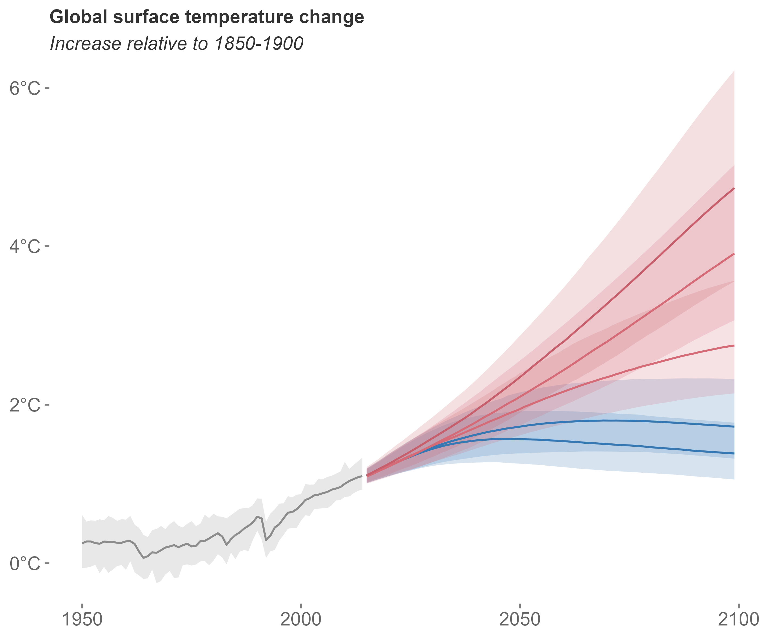
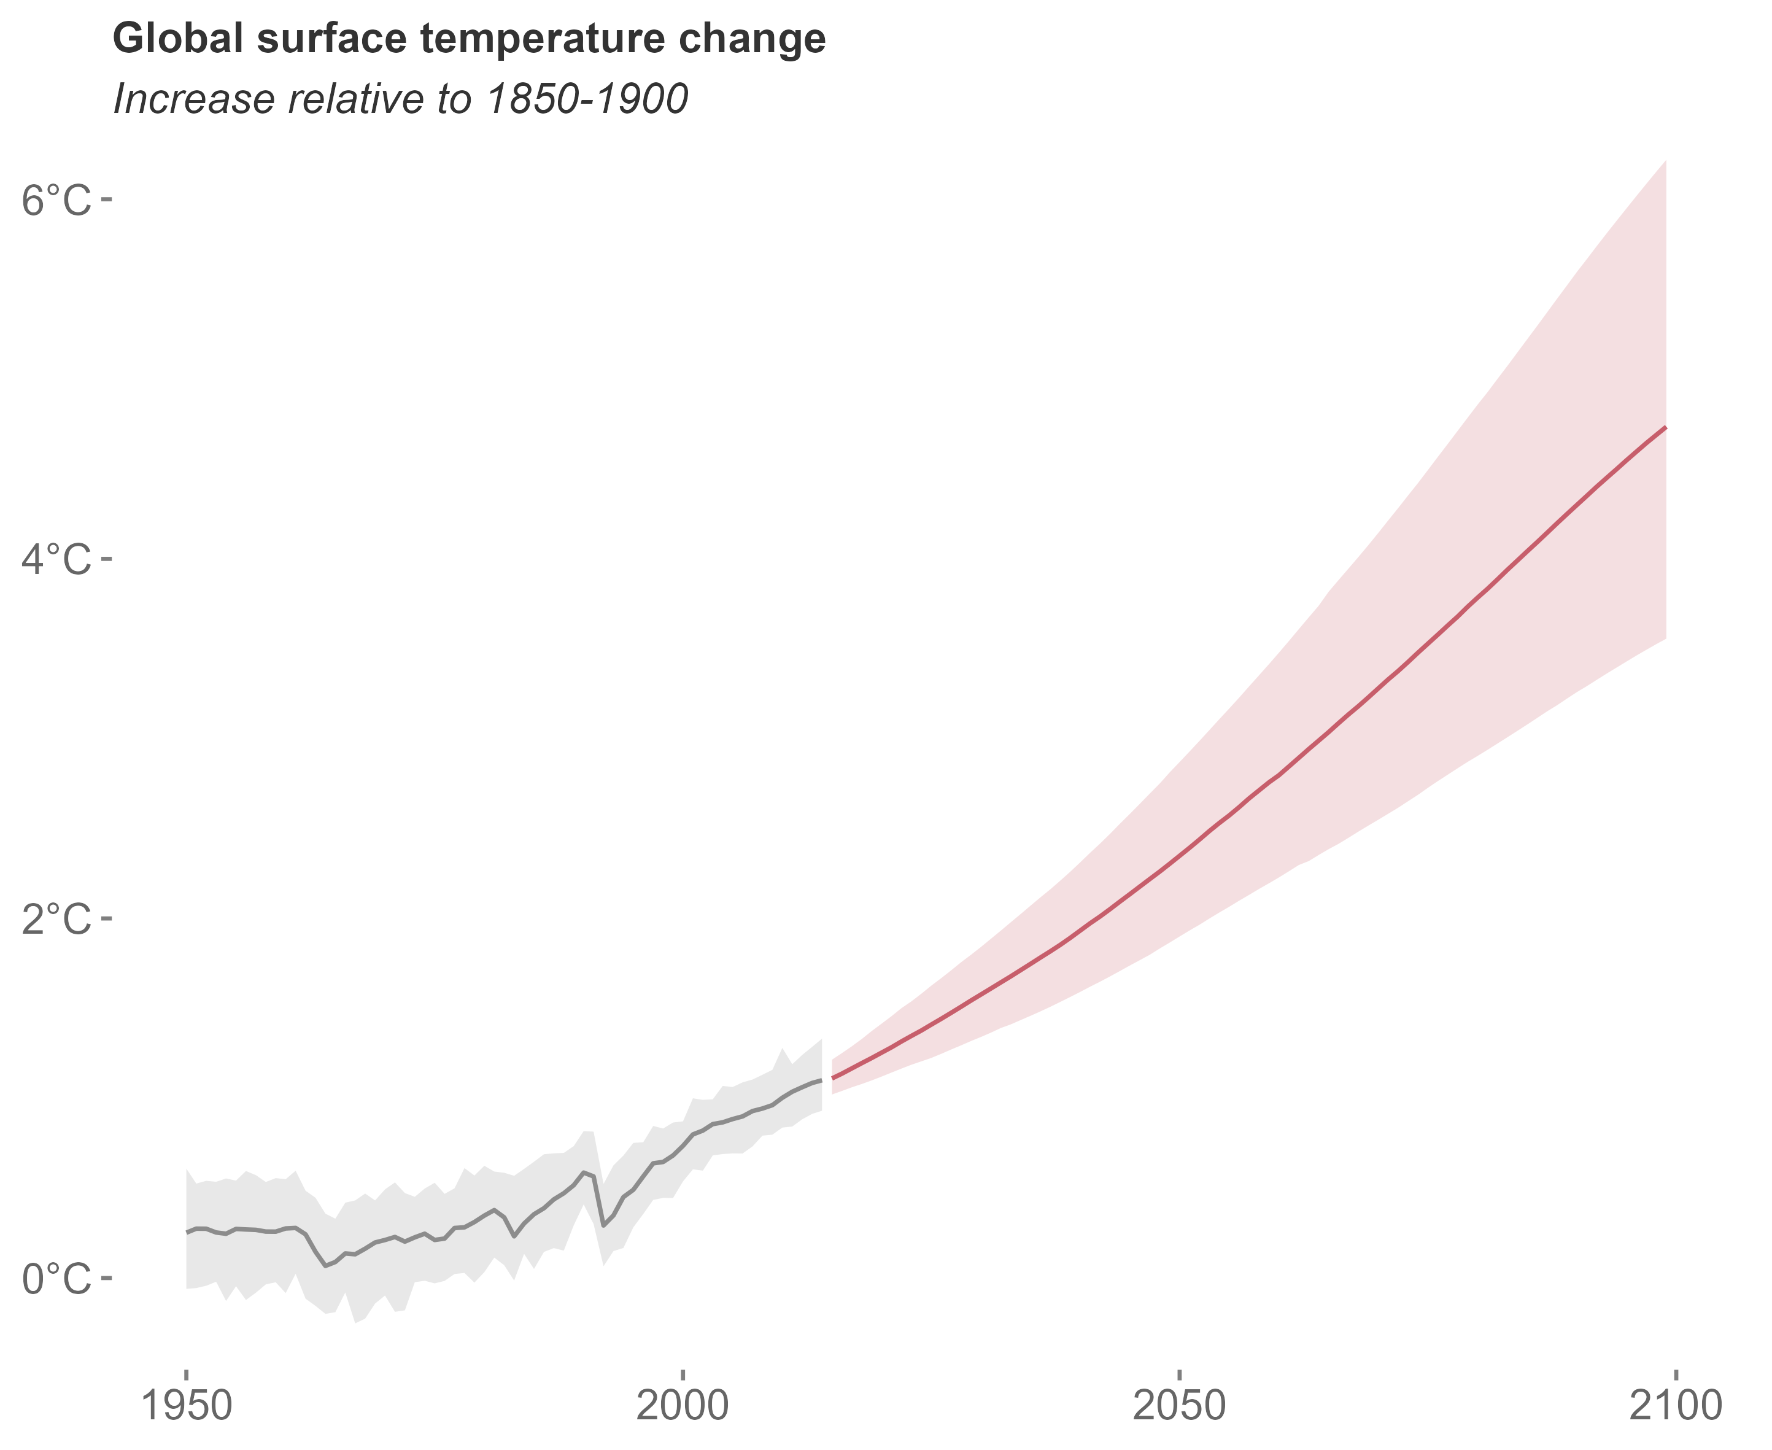
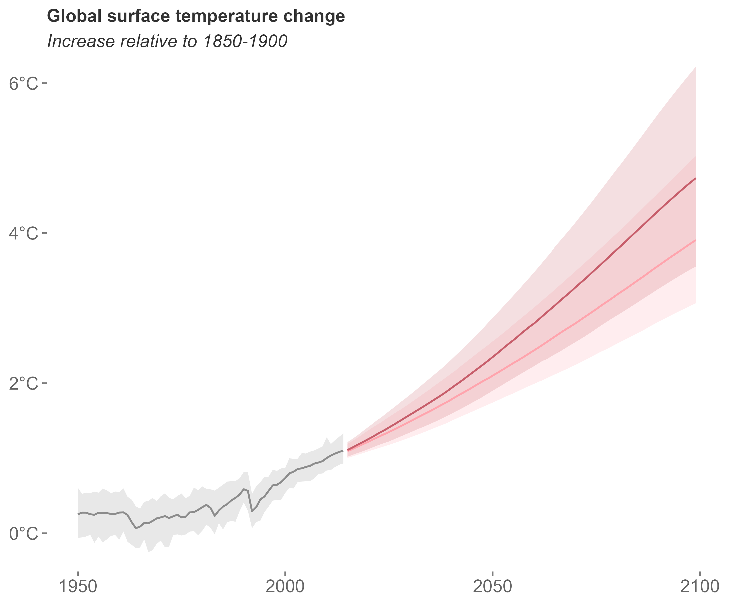
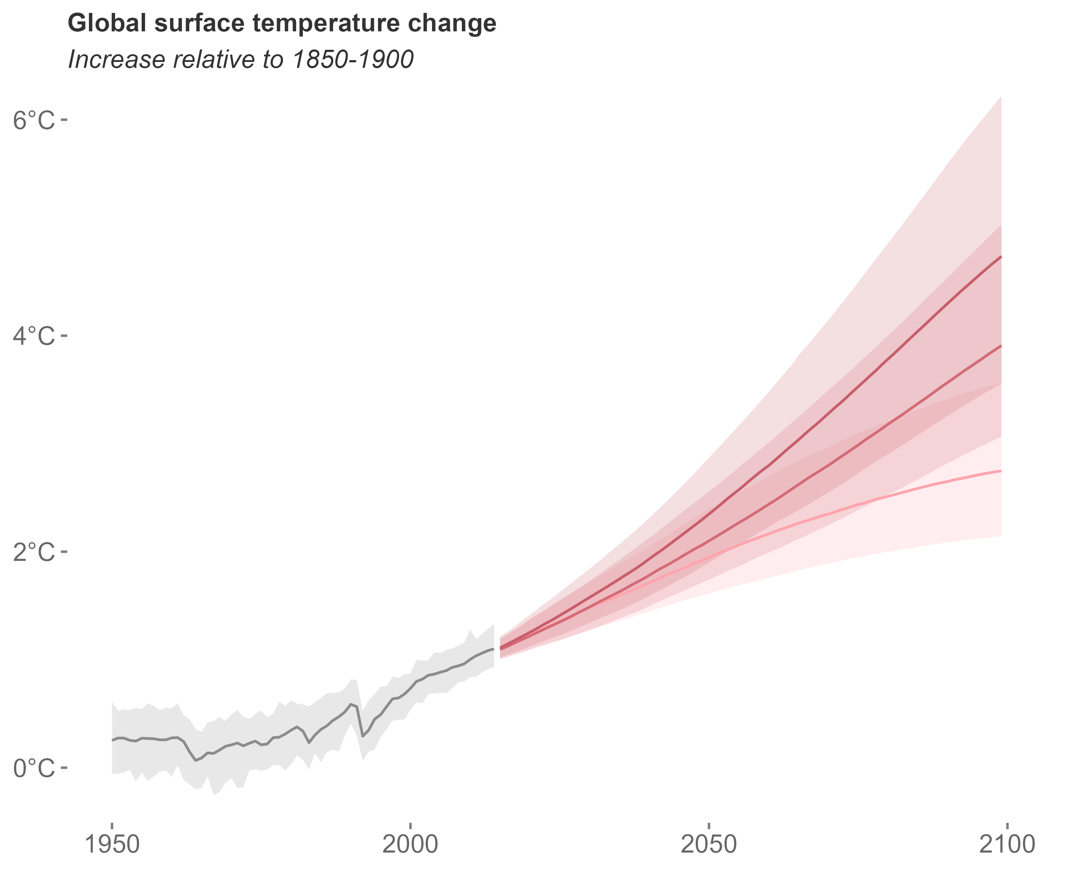
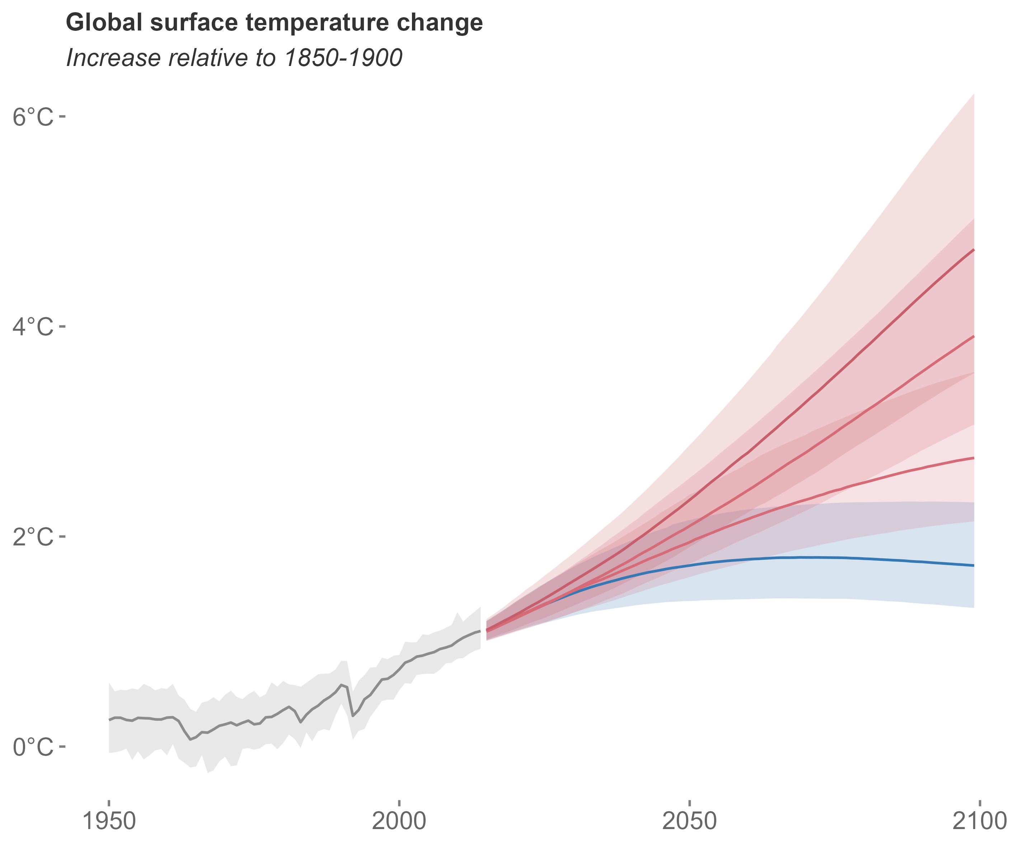
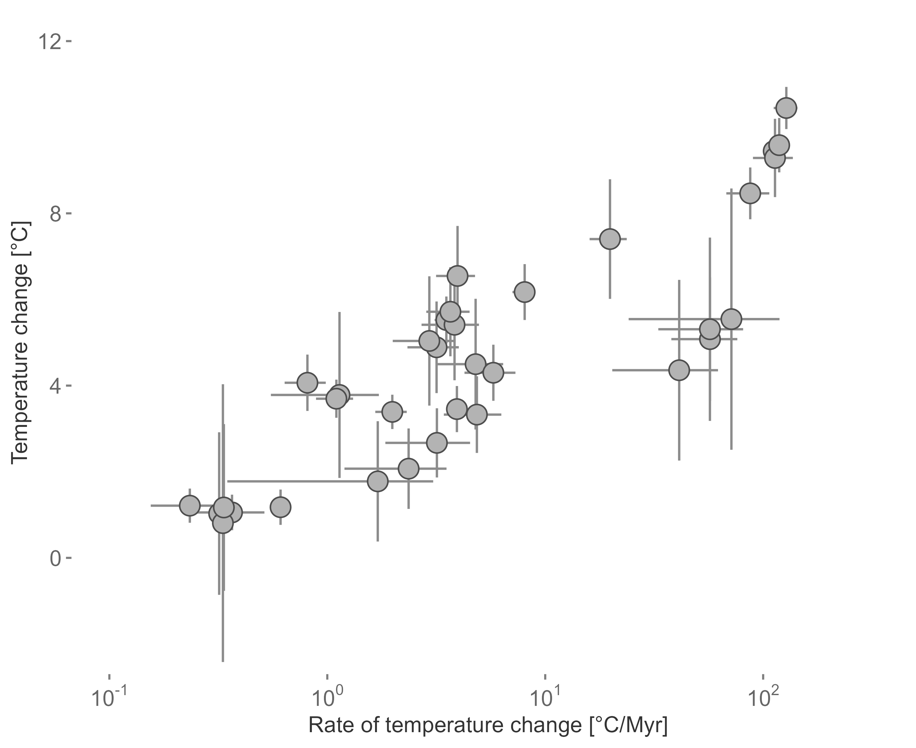
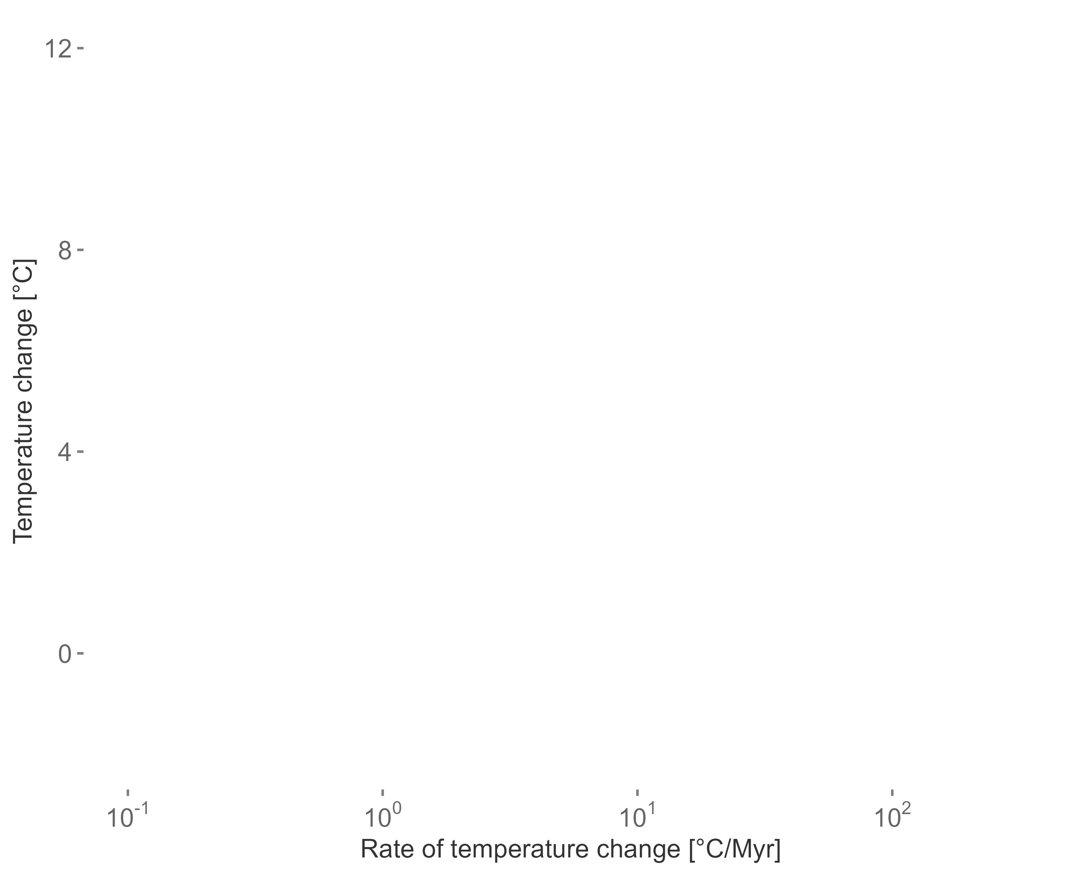
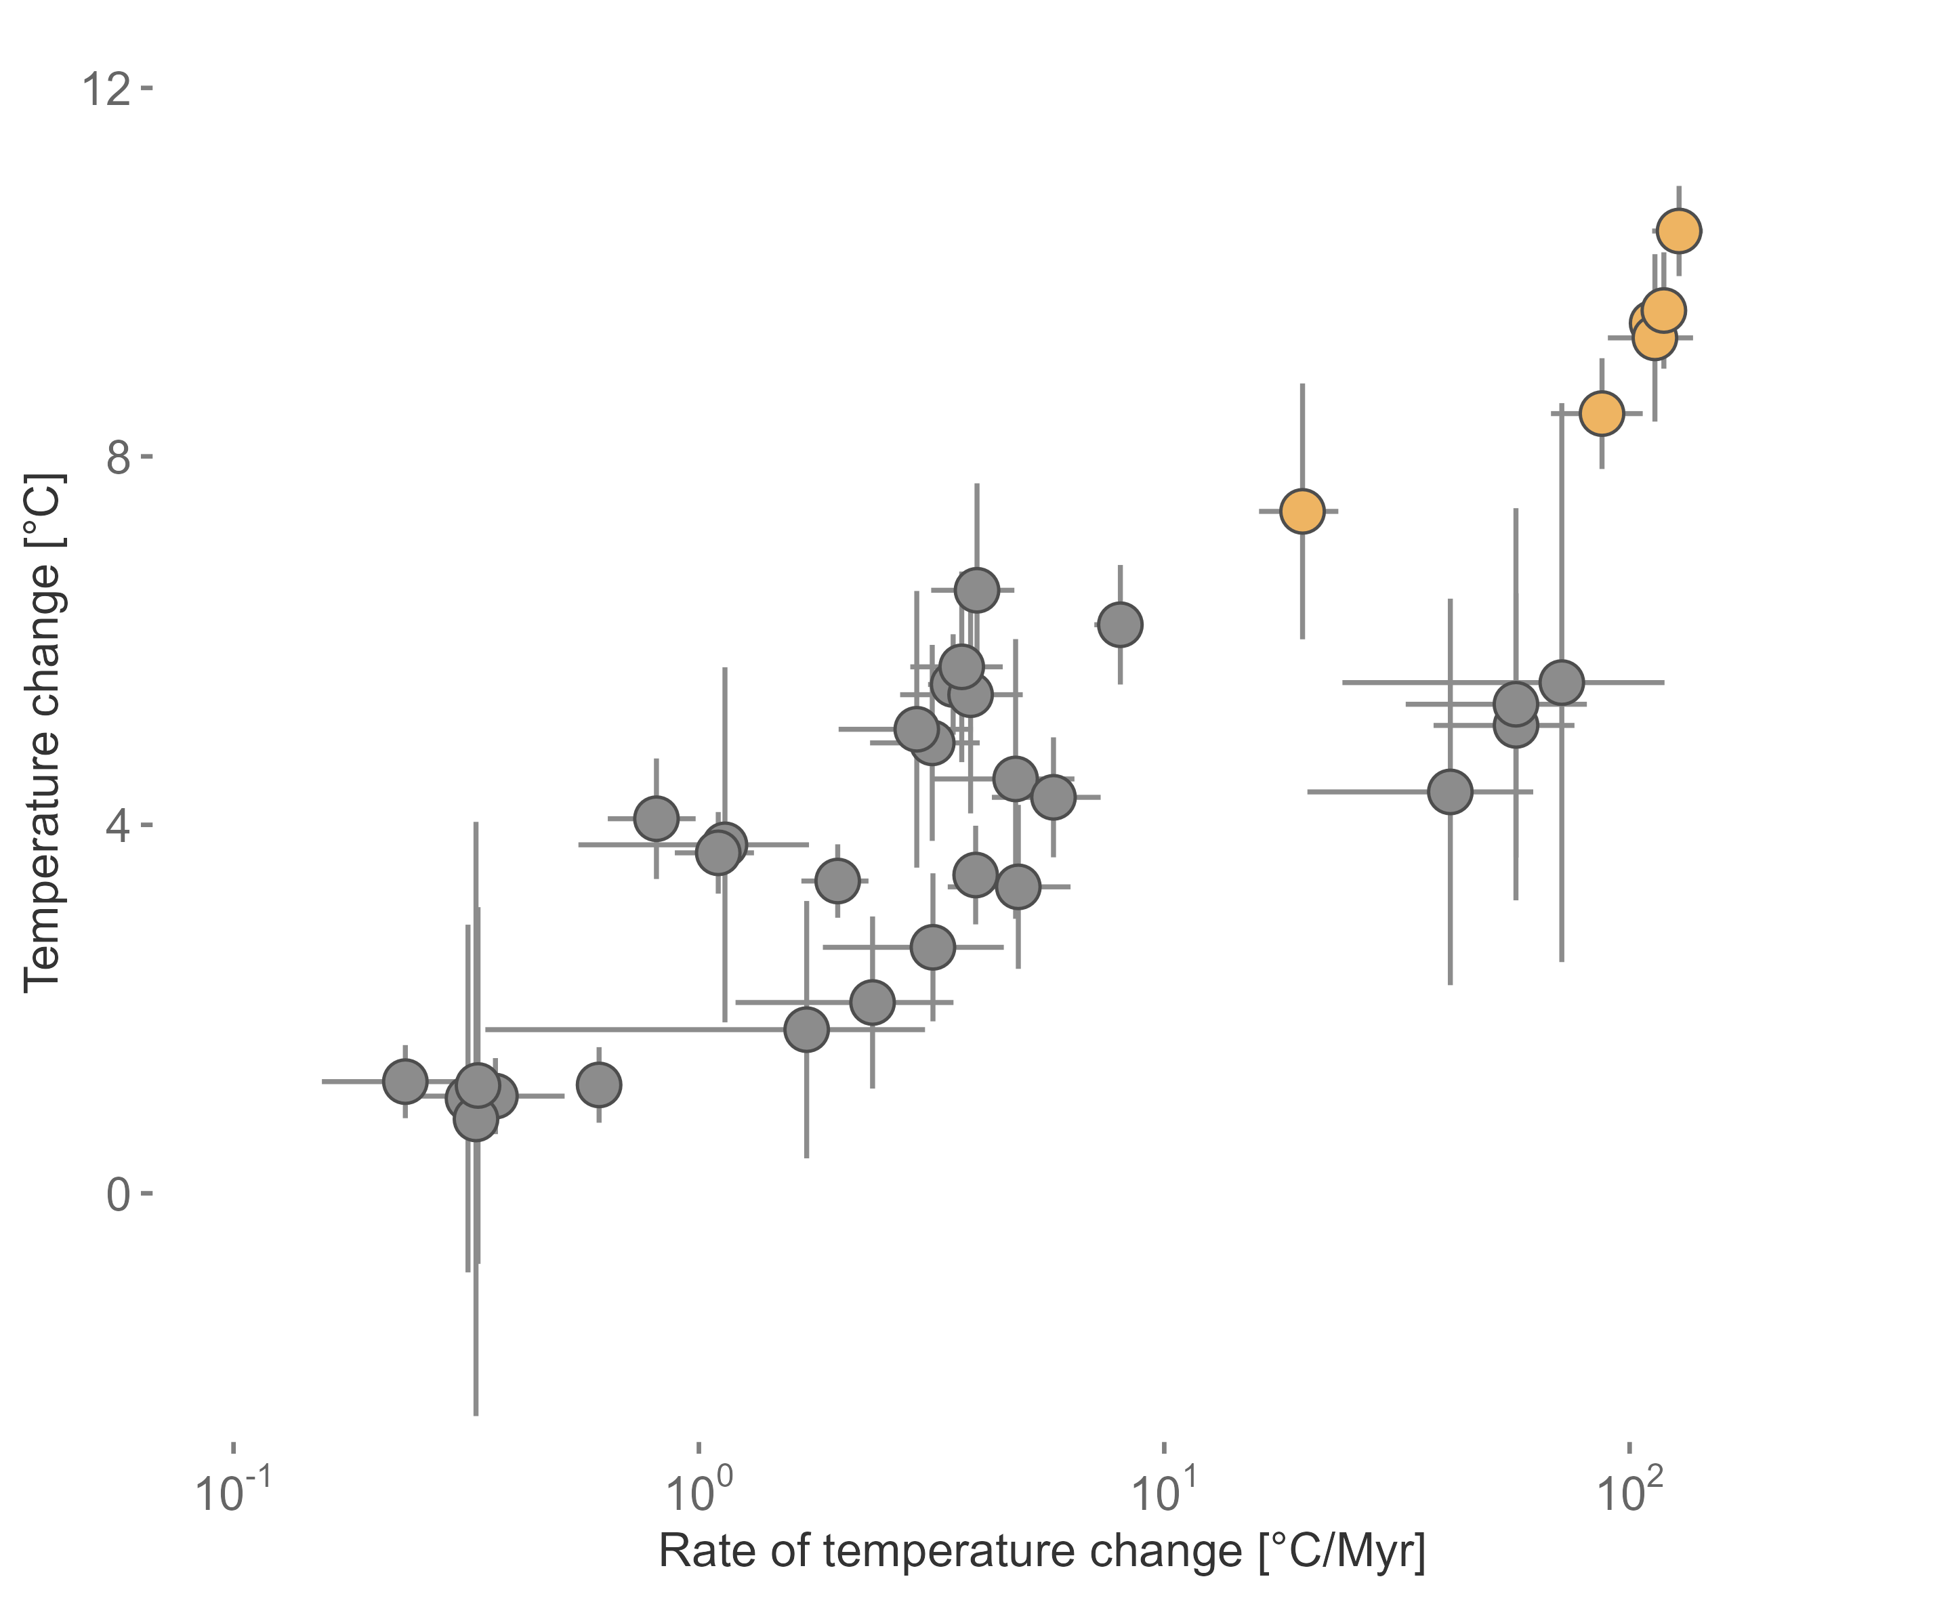


Two approaches
modified after IPCC 2022
modified after Song et al. 2022

Slide 4






Temporal context matters
Motivation and Background
PhD Chapters
Deep-Time
Extinction risk of fossils
Origination probability of fossils
Environmental data during extinction events
Near-Time
Rate of change in terrestrial plants
Assemblage turnover in planktonic foraminifera
Implementation in conservation science
Conclusion and Outlook
Meta-analysis and review

Slide 5
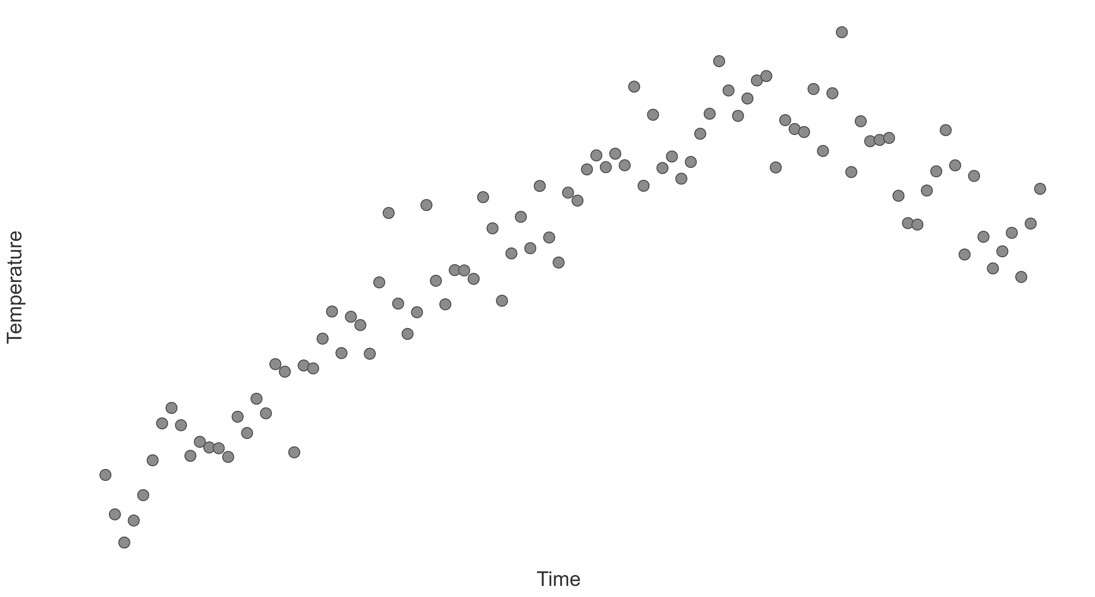
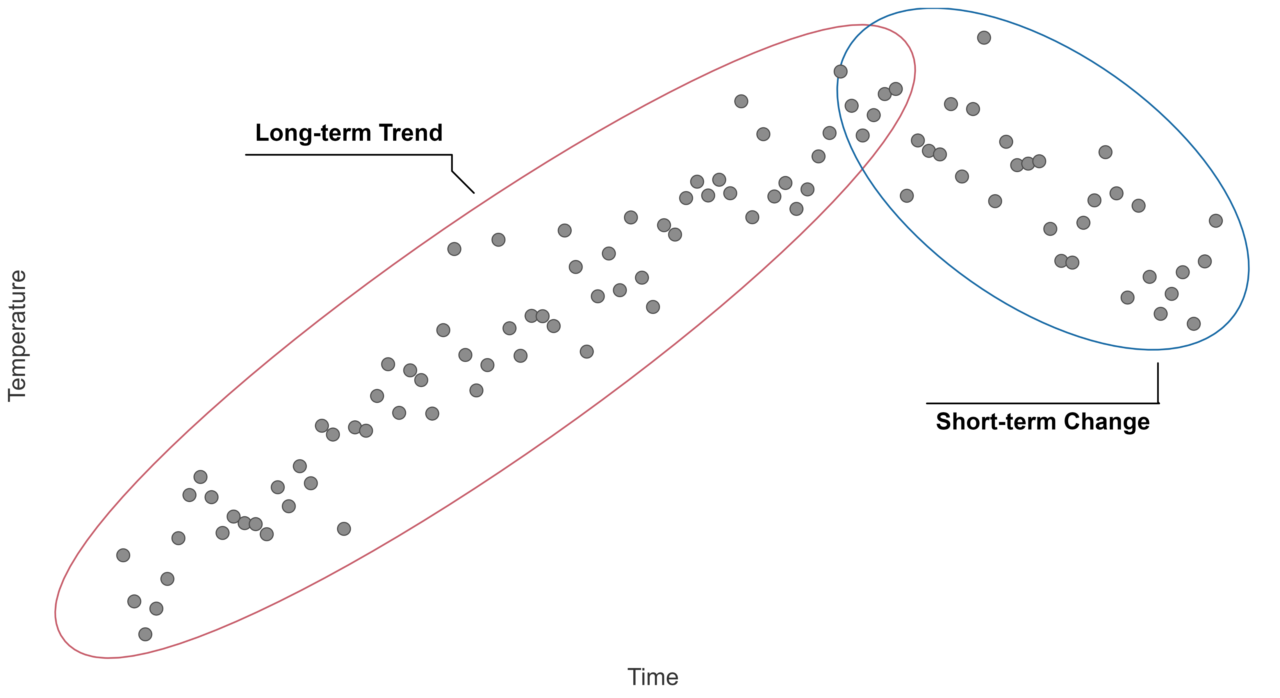
Temporal context

Slide 6
Niche stability
- Temperature +
Topt
Time
Performance
Tmin
Tmax
Temperature
Wiens and Graham 2005
Lieberman and Saupe 2016
Steinbauer et al. 2016

Slide 7
Niche stability
- Temperature +
Topt
Time
Performance
Tmin
Tmax
Temperature
Wiens and Graham 2005
Lieberman and Saupe 2016
Steinbauer et al. 2016

Slide 8
Climate interaction
- Temperature +
- Temperature +
Time
Time
- Temperature +
- Temperature +
Time
Time

Slide 9
Methodology
ΔTtrend₁
ΔTtrend₂
- Temperature +
ΔTchange
ΔTtrend₃
Time
Environmental data
X
X
X
X
X
X
X
X
X
X
X
Extinction
∫_{Time}
Extinction/survival(1,0,1,0)
Model
Extinction ~ ΔTchange : ΔTtrend + (random structure)

Slide 10






Extinction risk
δ¹⁸O
Genera
PaleoBioDB
Extinction events
Marine and terrestrial
6 million years / 6 to 24 million years

Slide 11
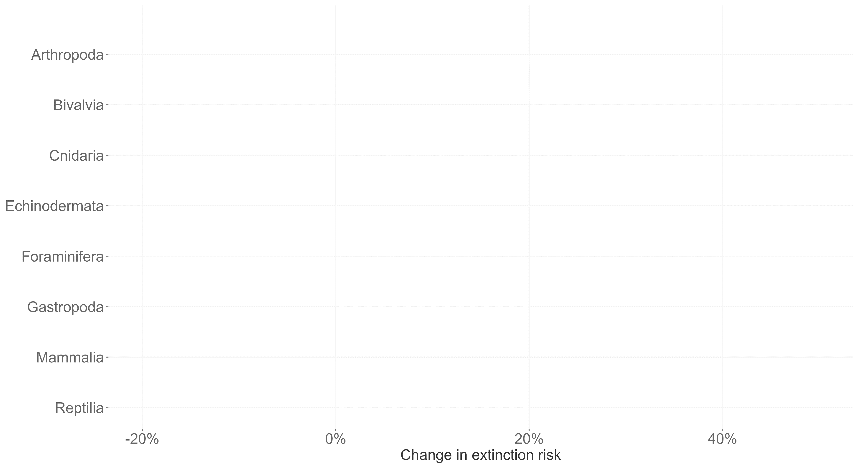
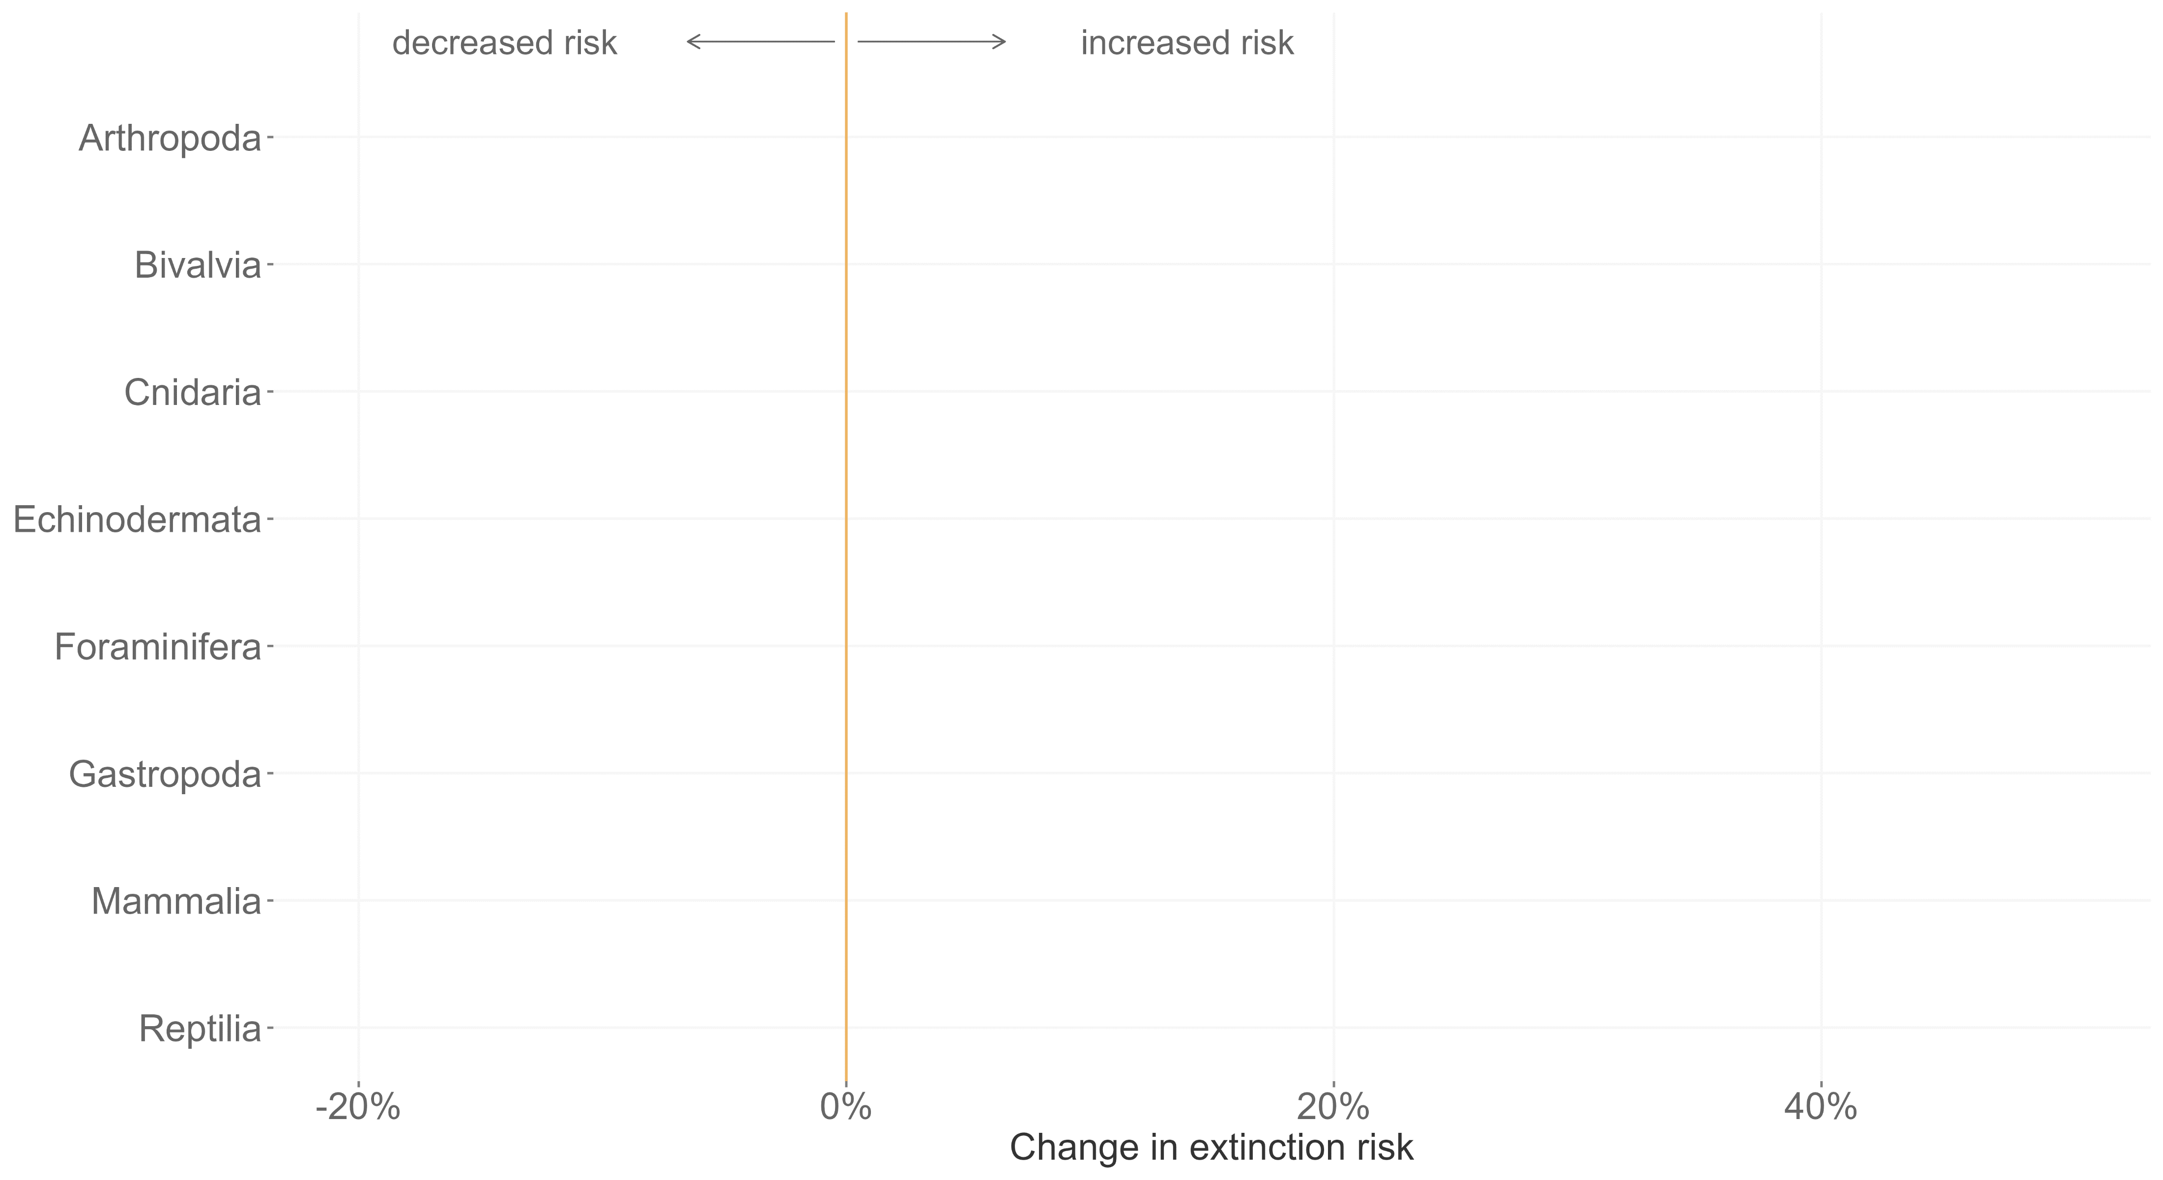
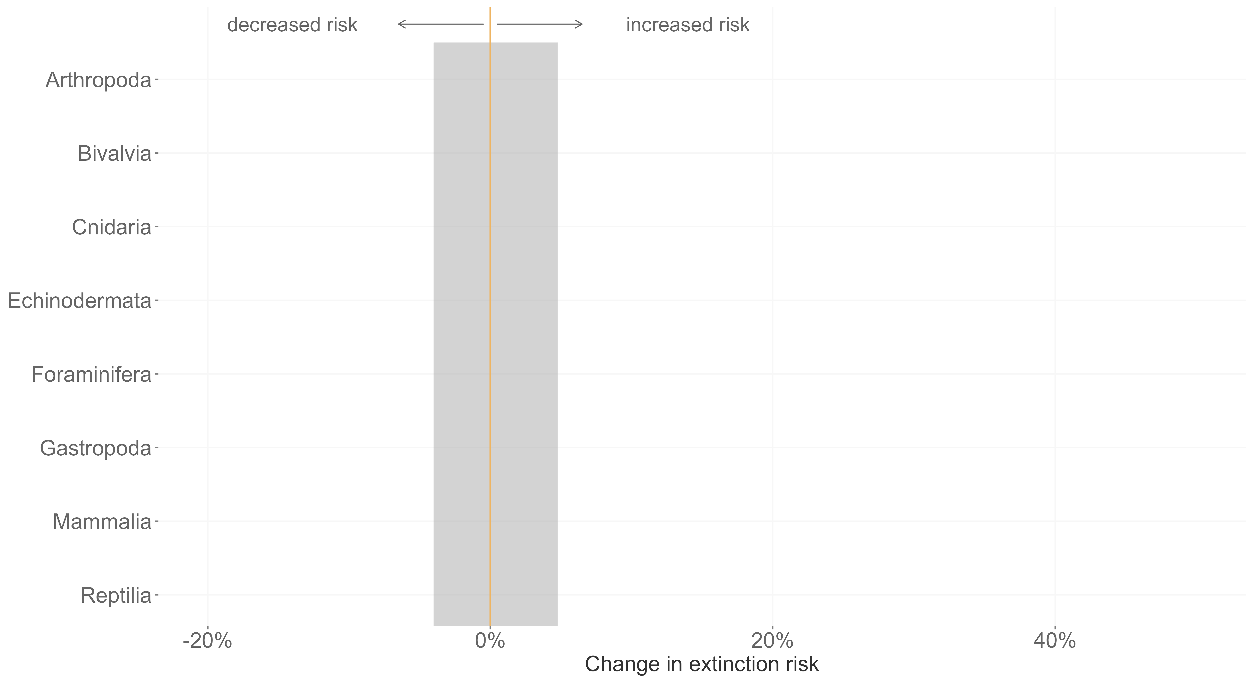
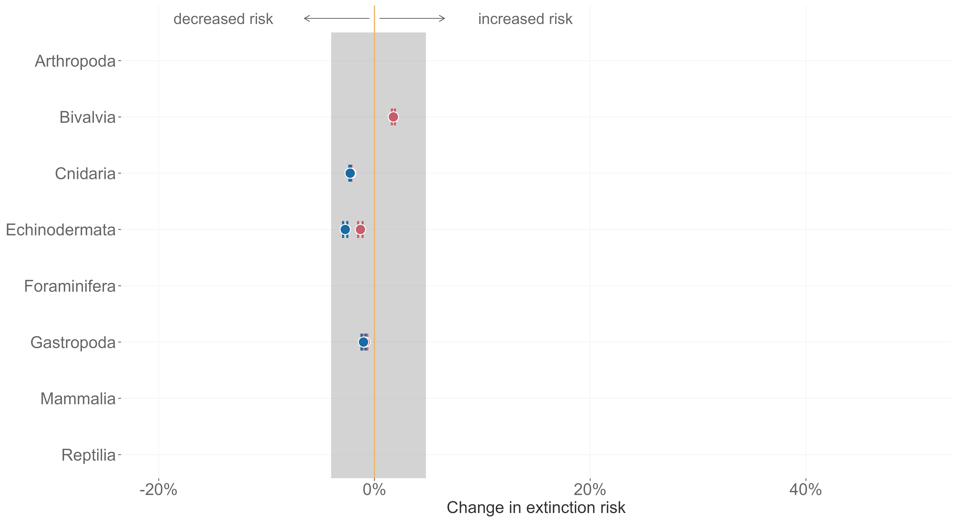
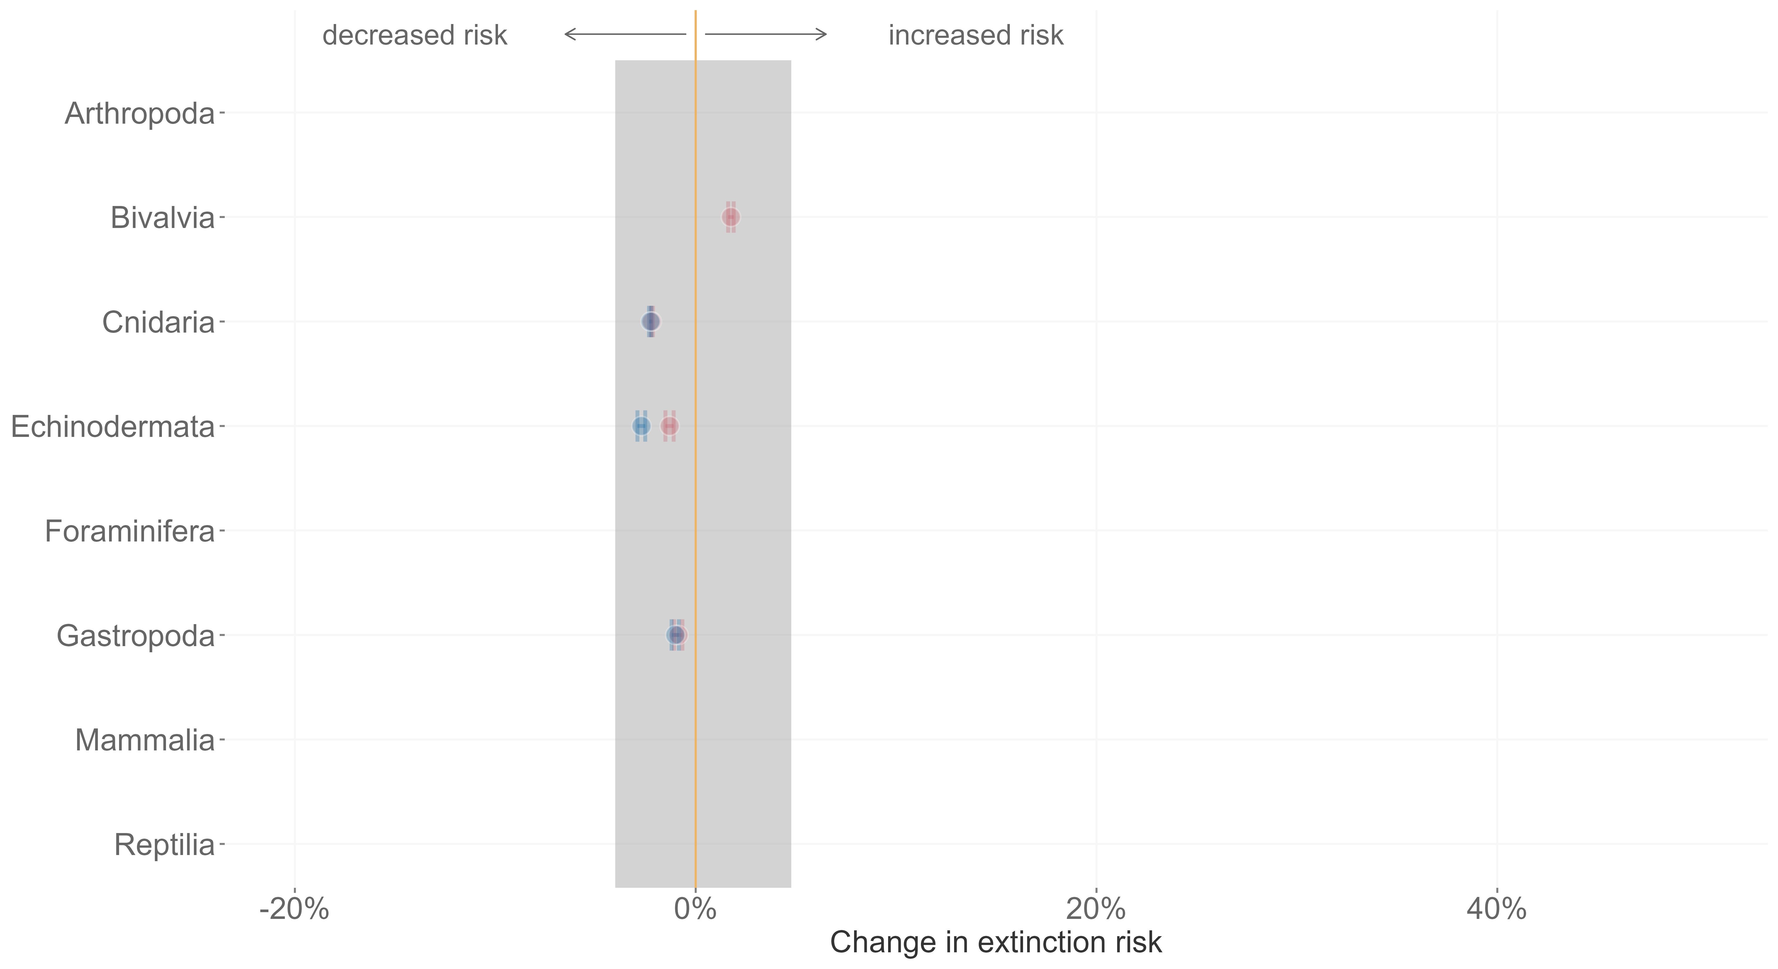
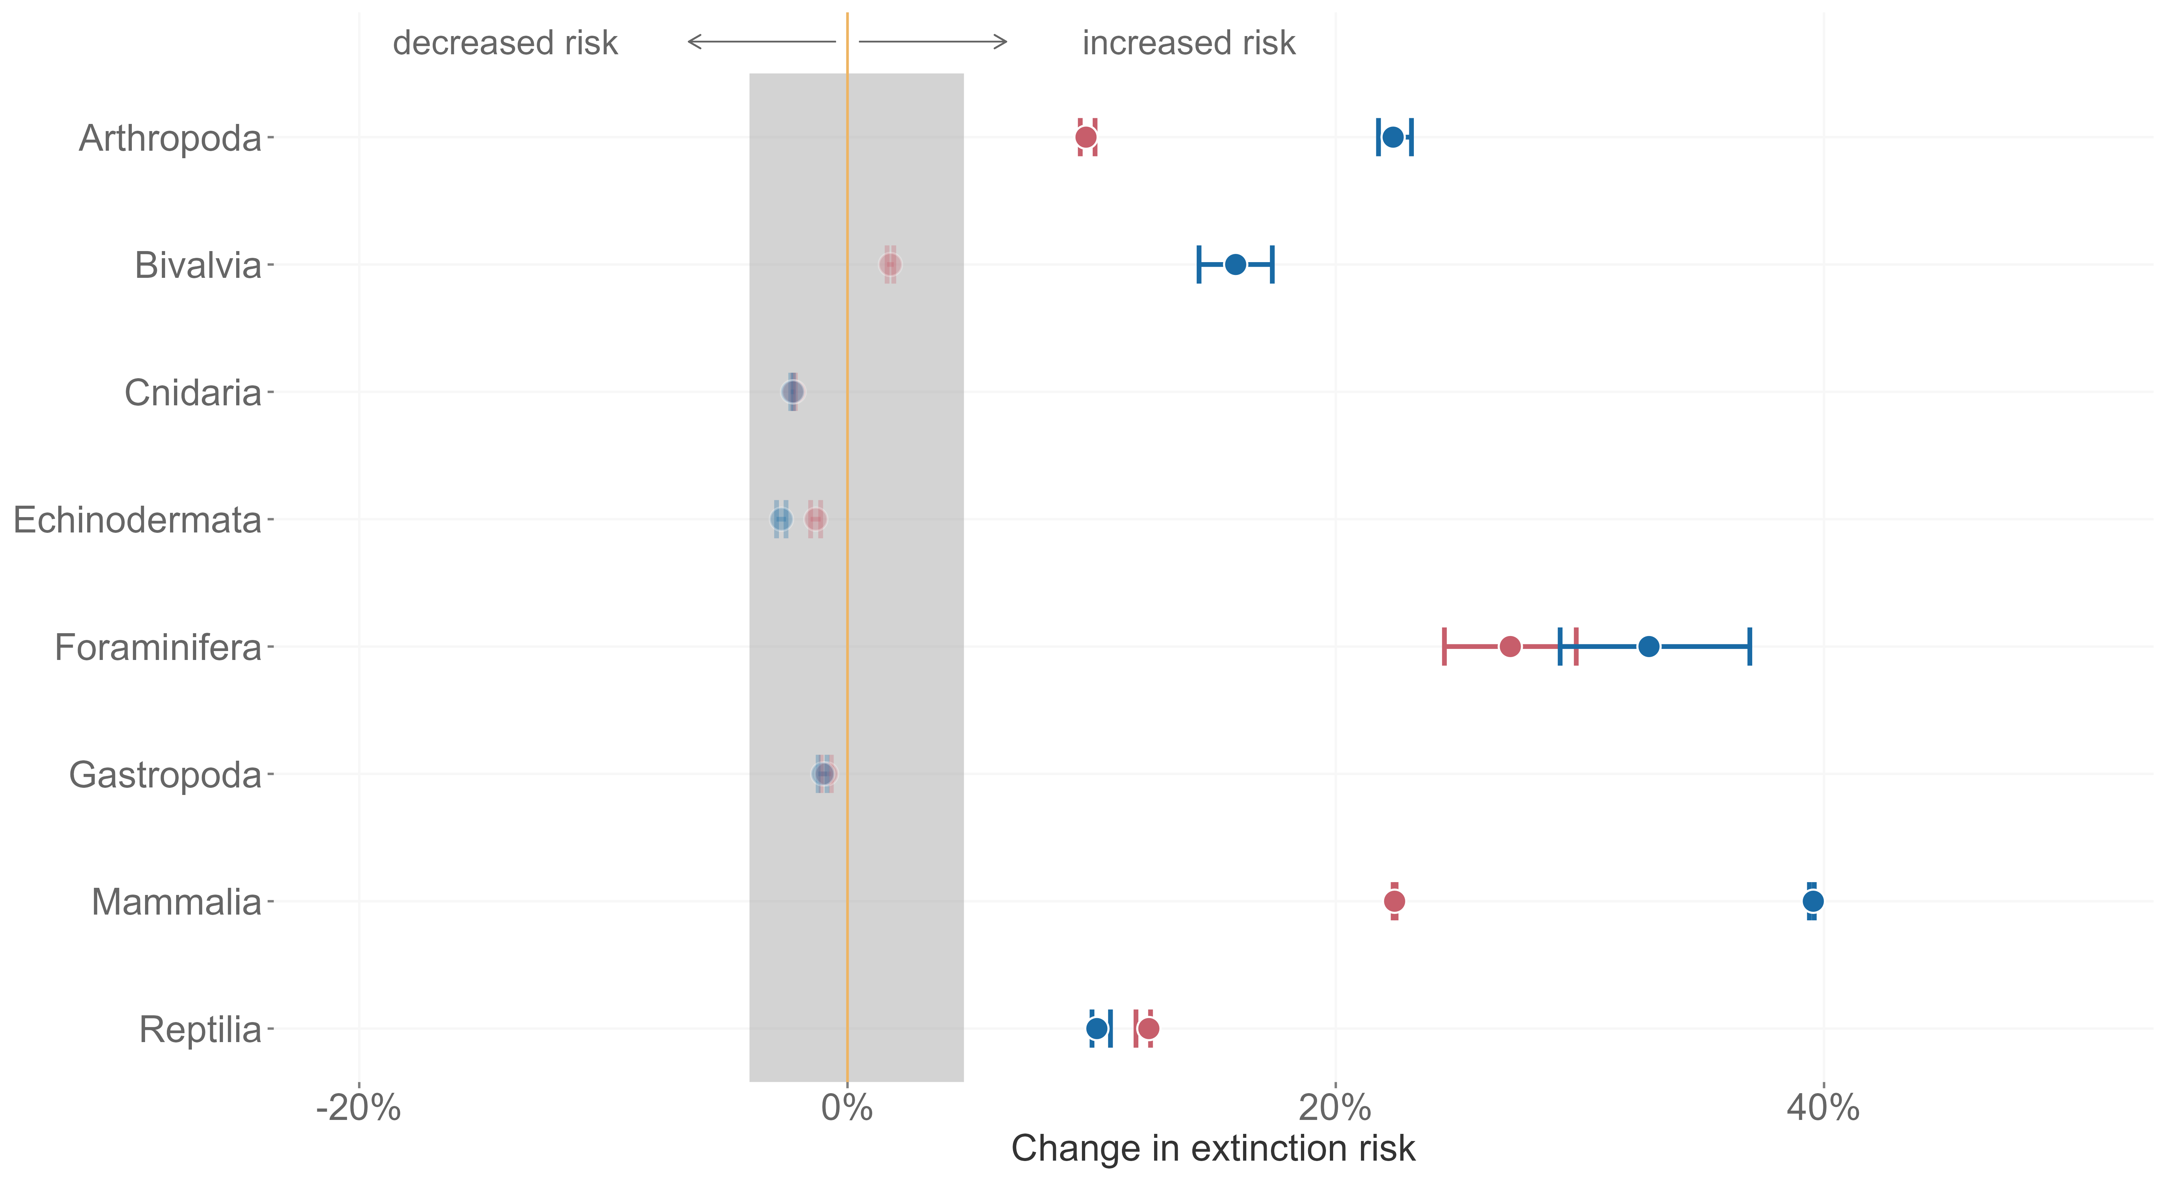
Mathes et al. 2021, Nature Ecology and Evolution

Slide 12

Origination probability
δ¹⁸O
Genera
PaleoBioDB
Marine only
Speciation events
6 million years / 6 to 24 million years

Slide 13
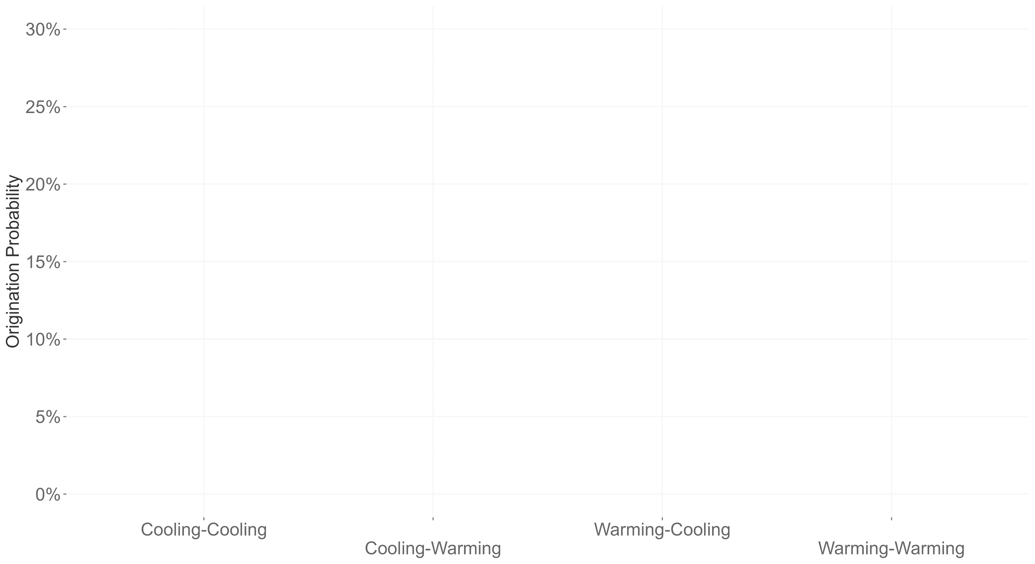
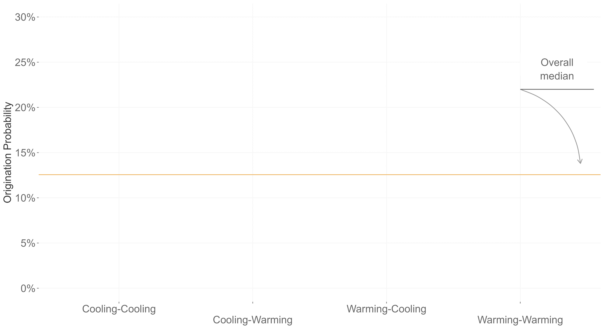
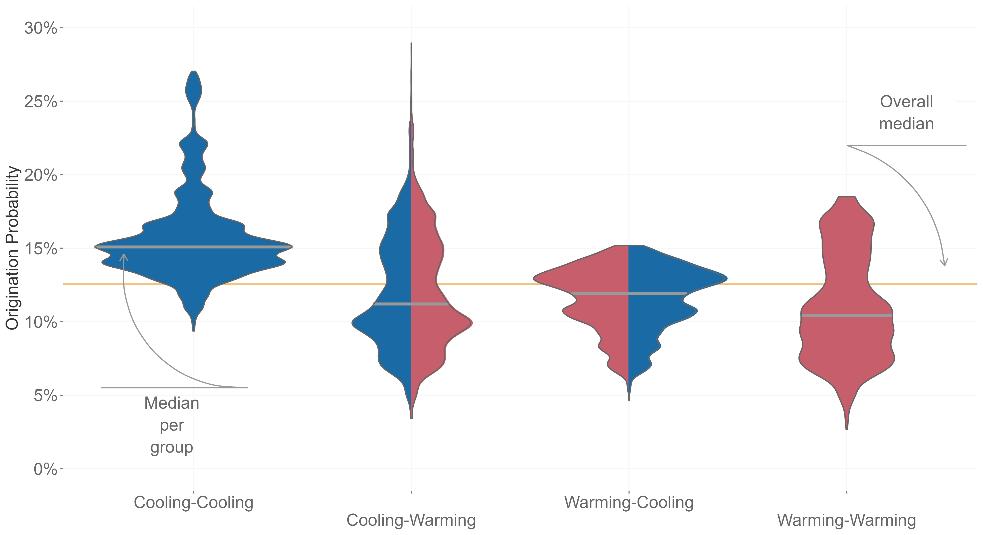
Mathes et al. 2021, PNAS

Slide 14

Rate of change
AOGCM
Pollen taxa
NeotomaDB
Terrestrial only
Vegetation turnover
100 years/ 100 to 1.000 years

Slide 15
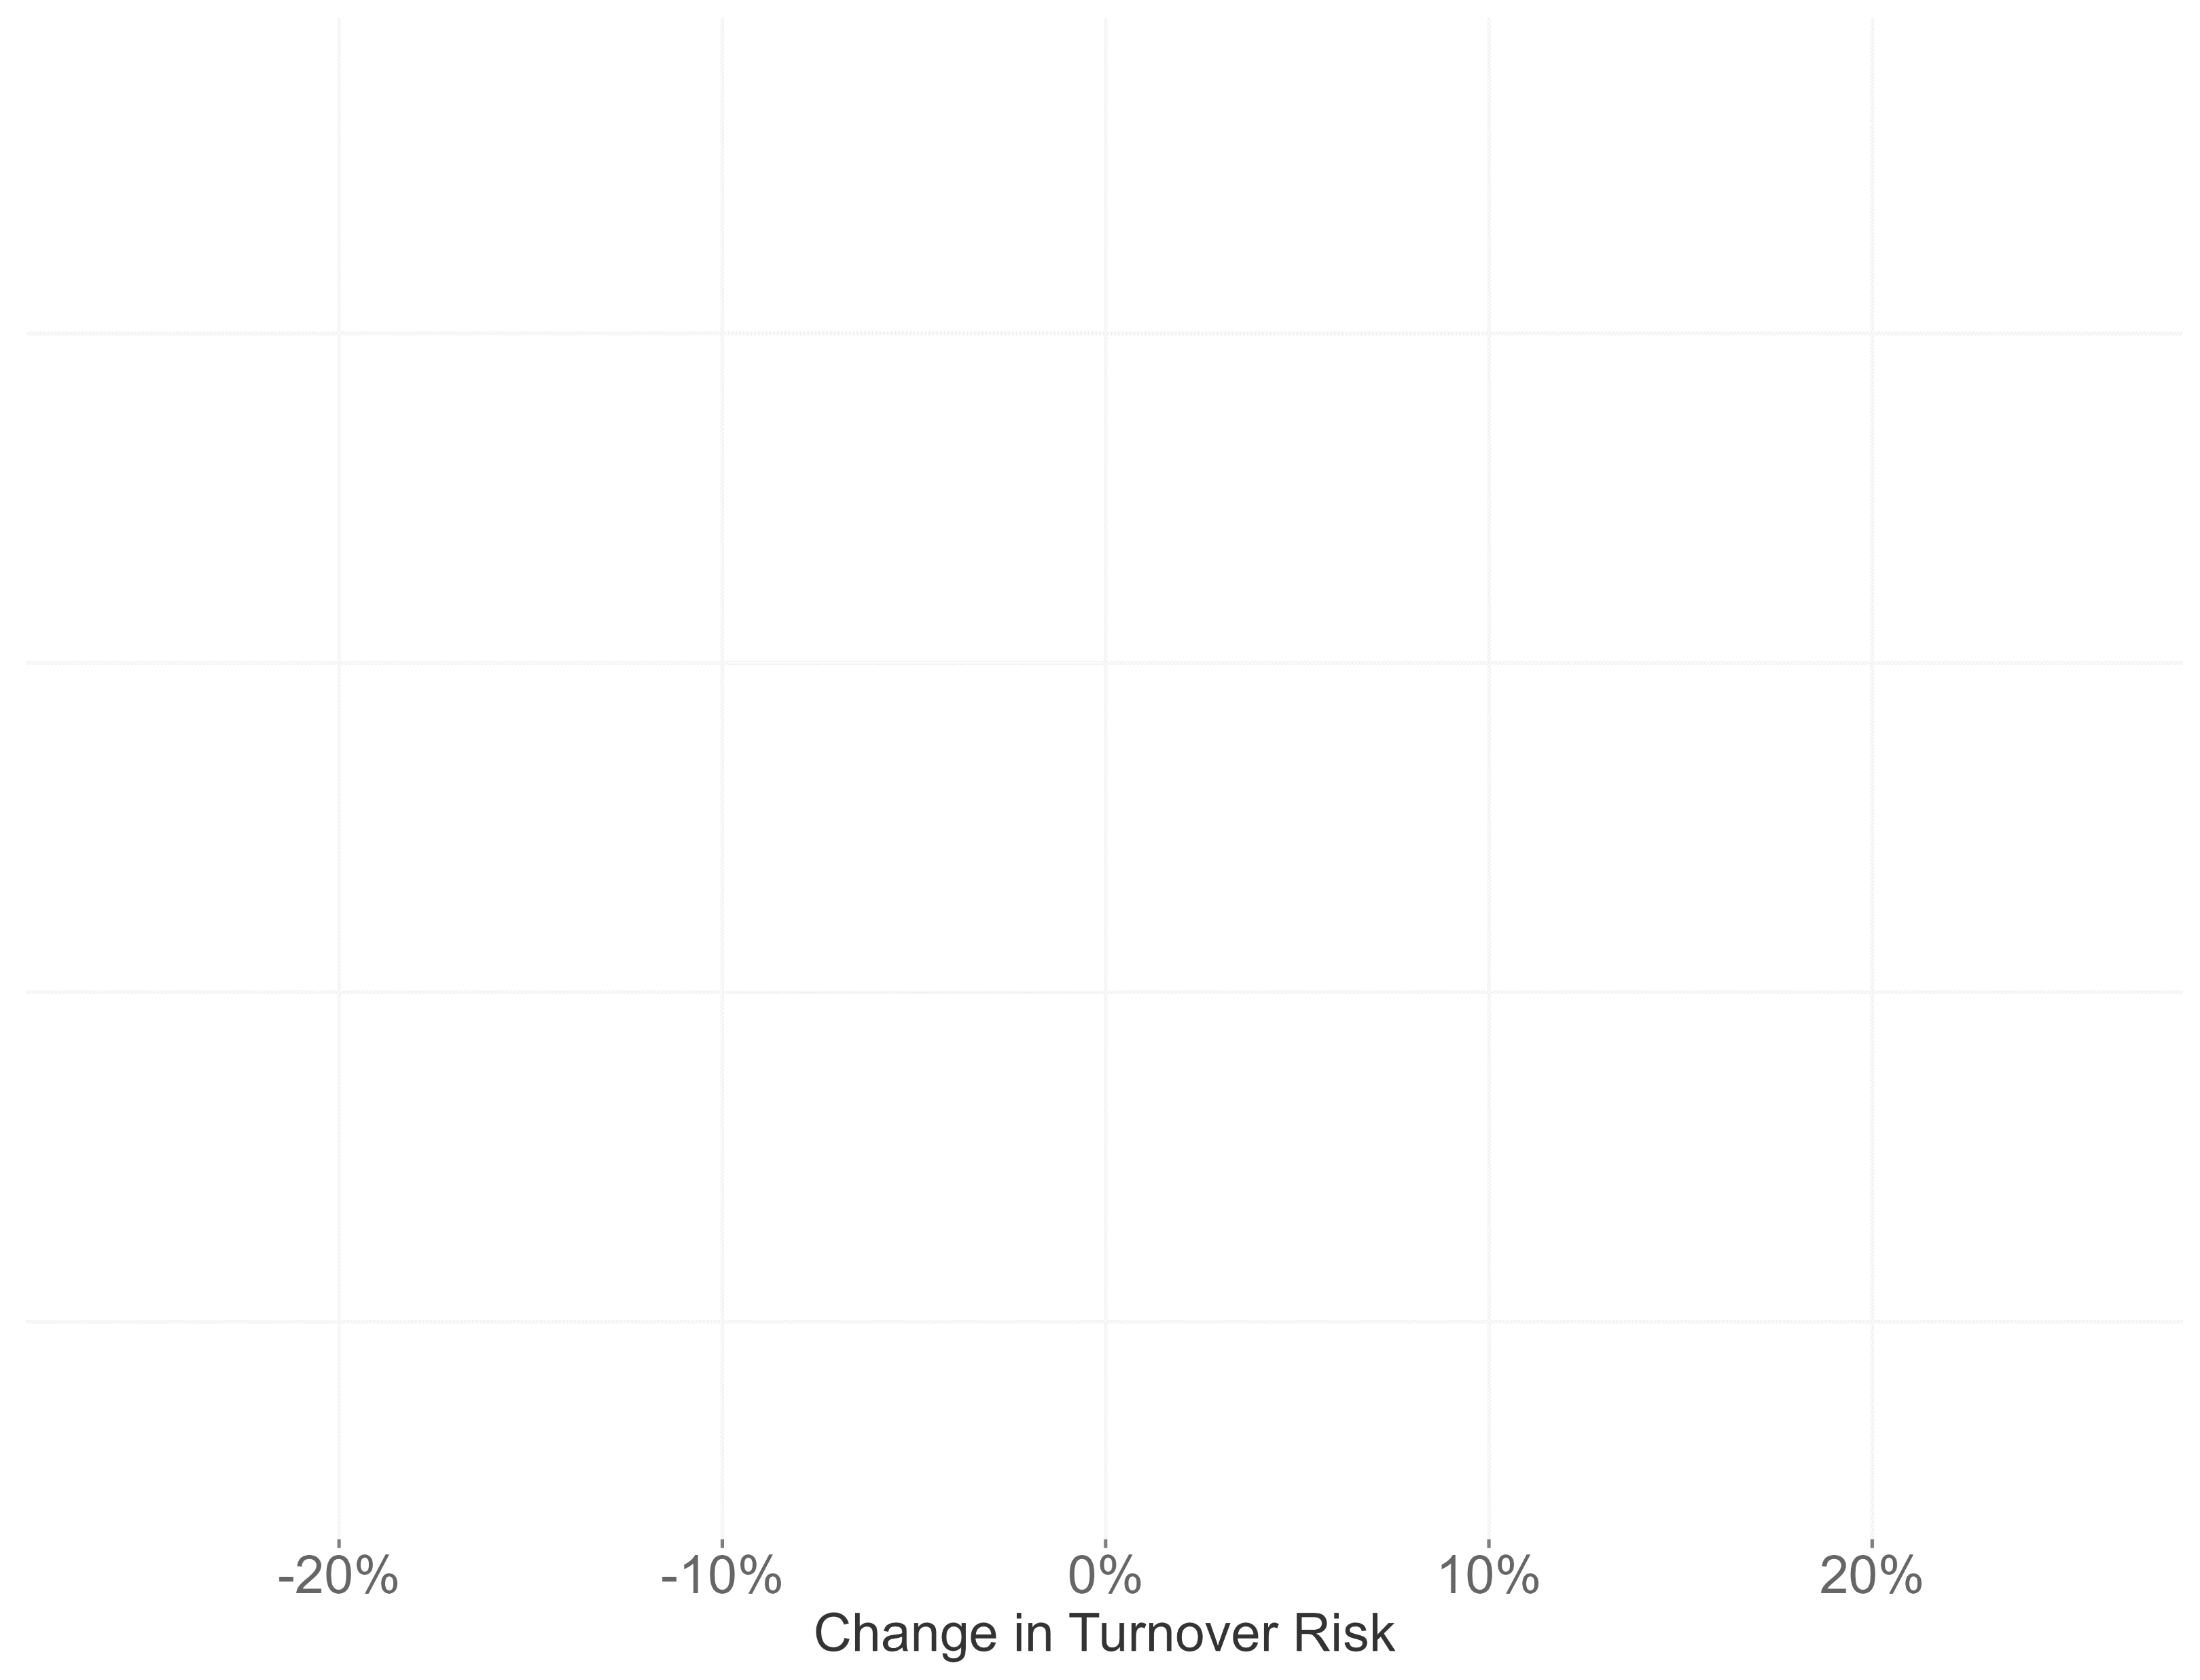
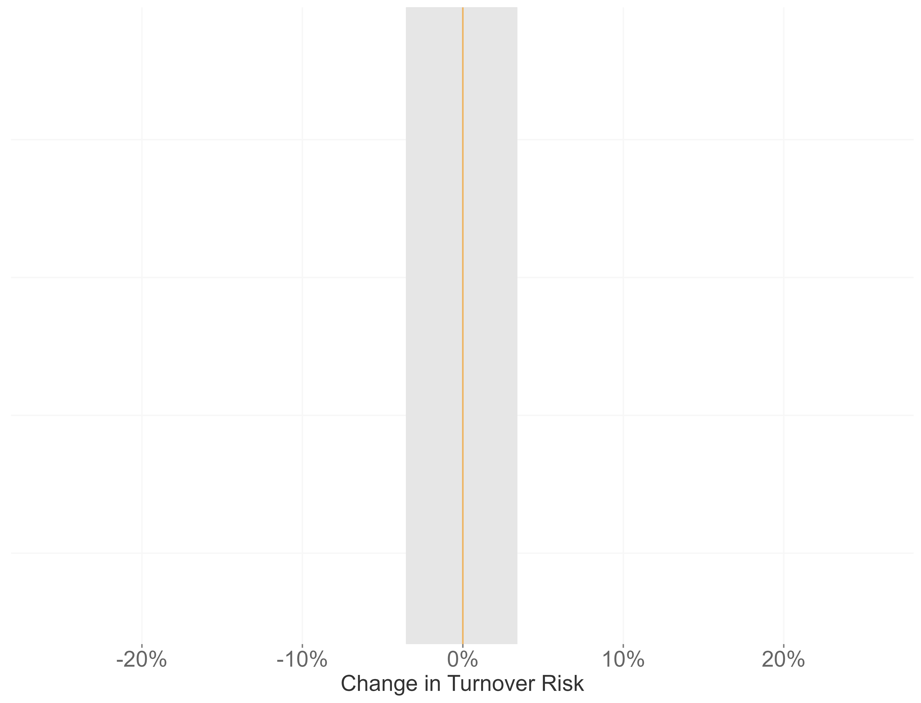
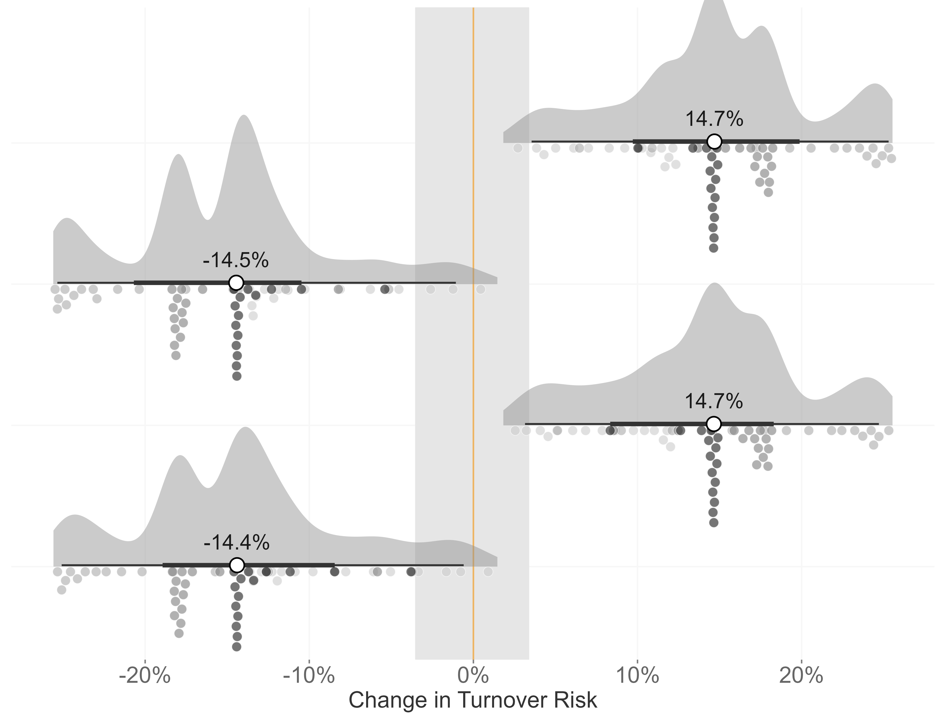
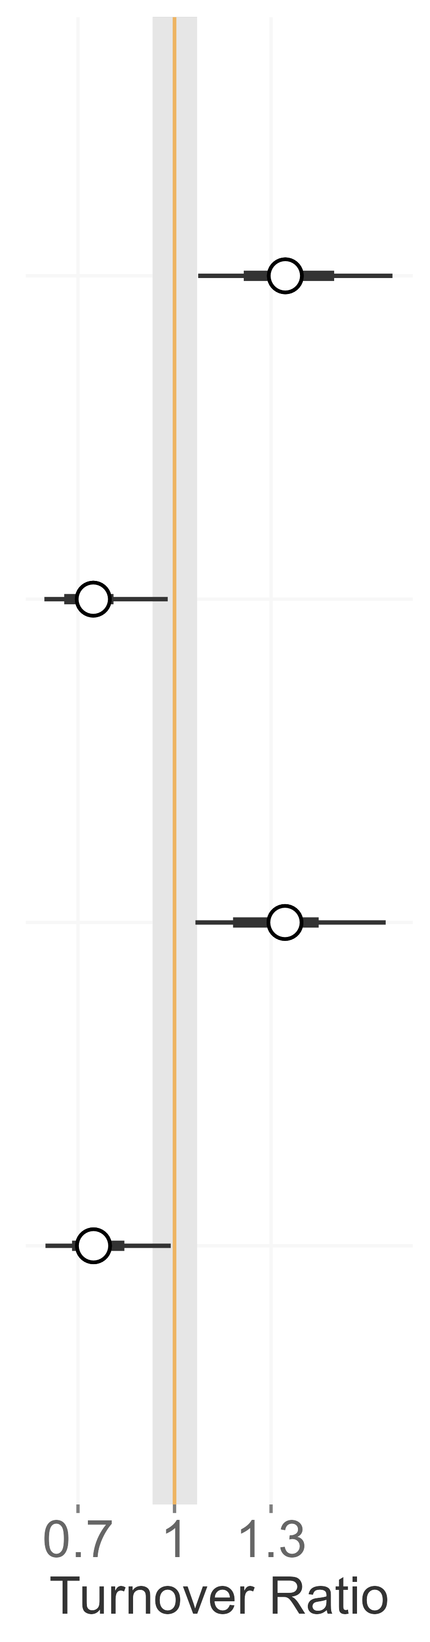
Climate Interaction
long-term
short-term
Mathes et al. 2023, in prep for resubmission

Slide 16
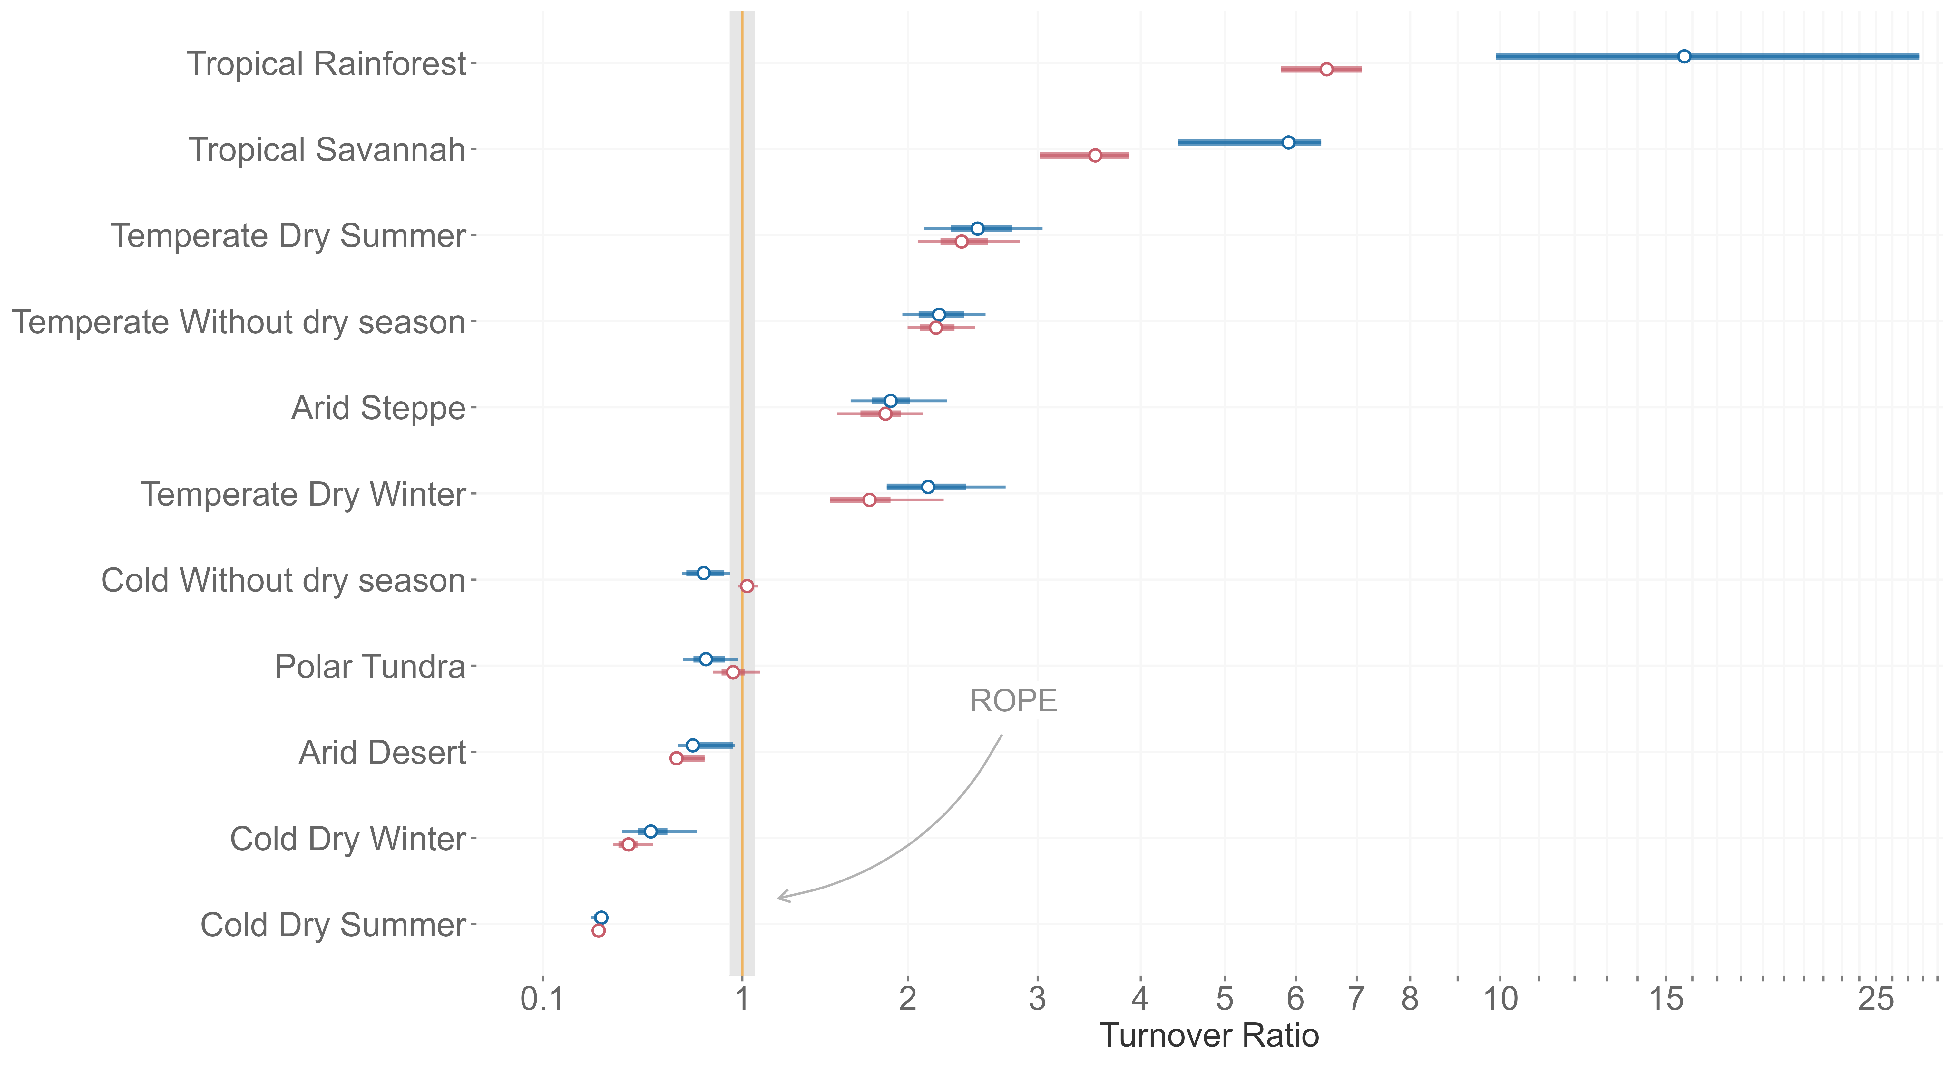
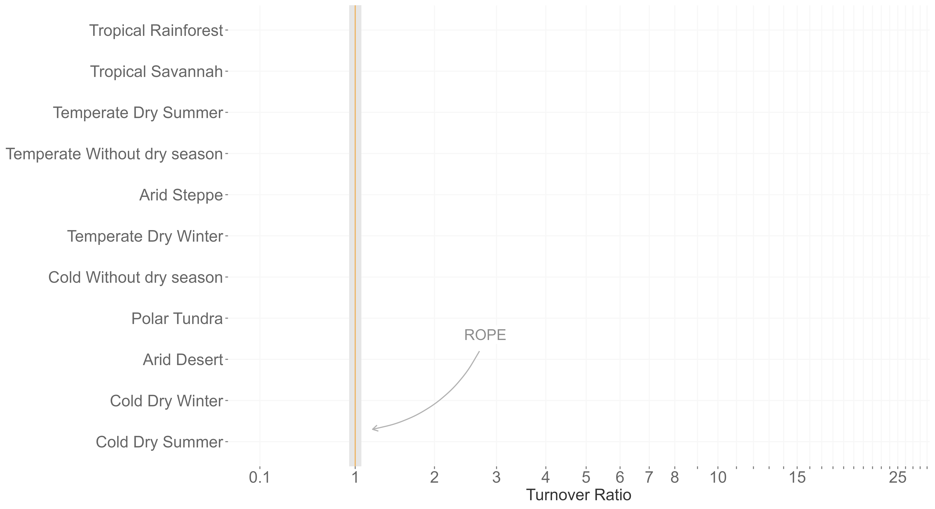
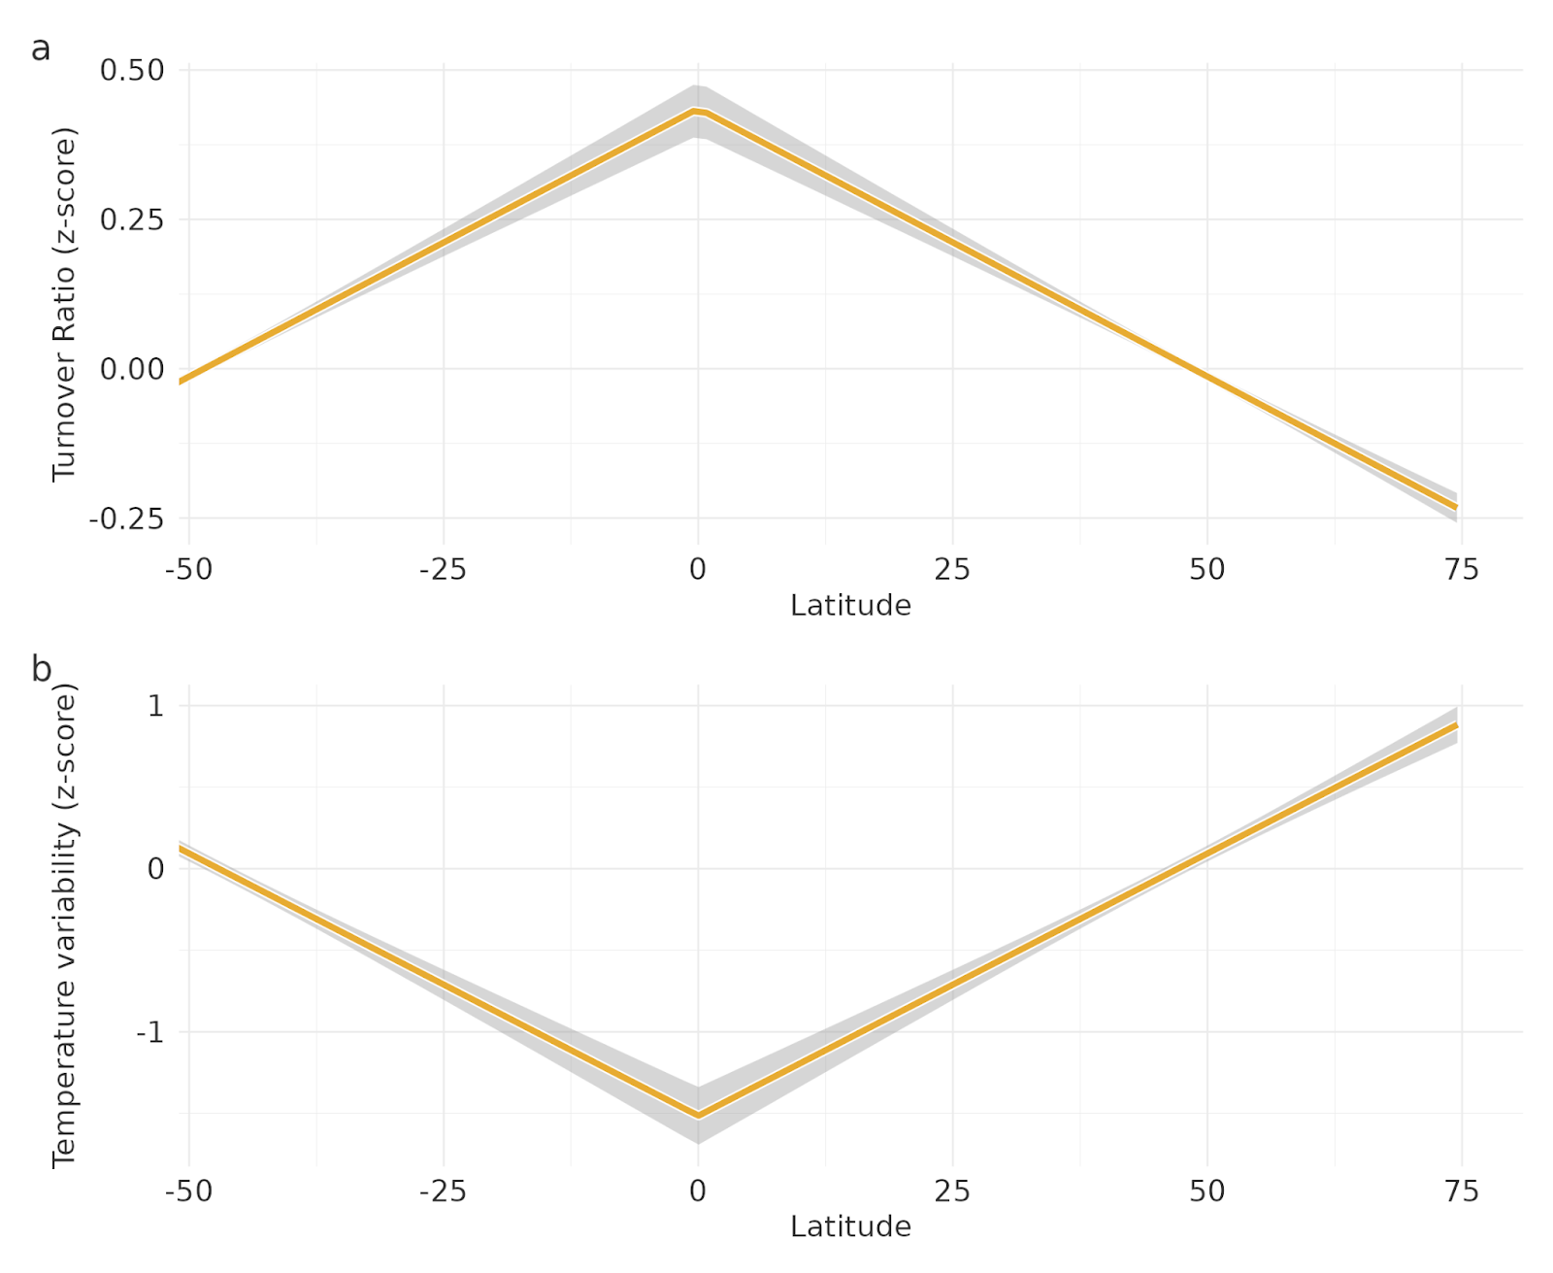
1
0
Temp. variability
-1
-50
-25
0
25
50
Latitude

Slide 17
